Slide 1
Intelligent Book Figures

Slide 2

Logo
Prompt: Please generate a minimalistic image of a orange book with the lowercase letter "i" on it. Use blue for the background.

Slide 3
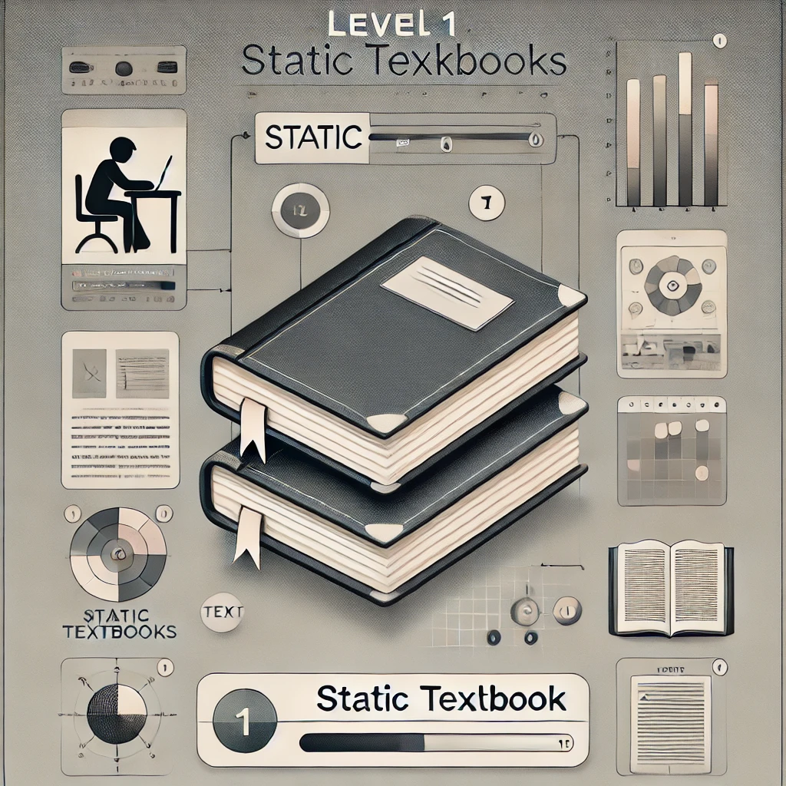
Level 1
Static textbook
Table of contents
Glossary of terms
Index
Static charts and figures
No interactivity

Slide 4
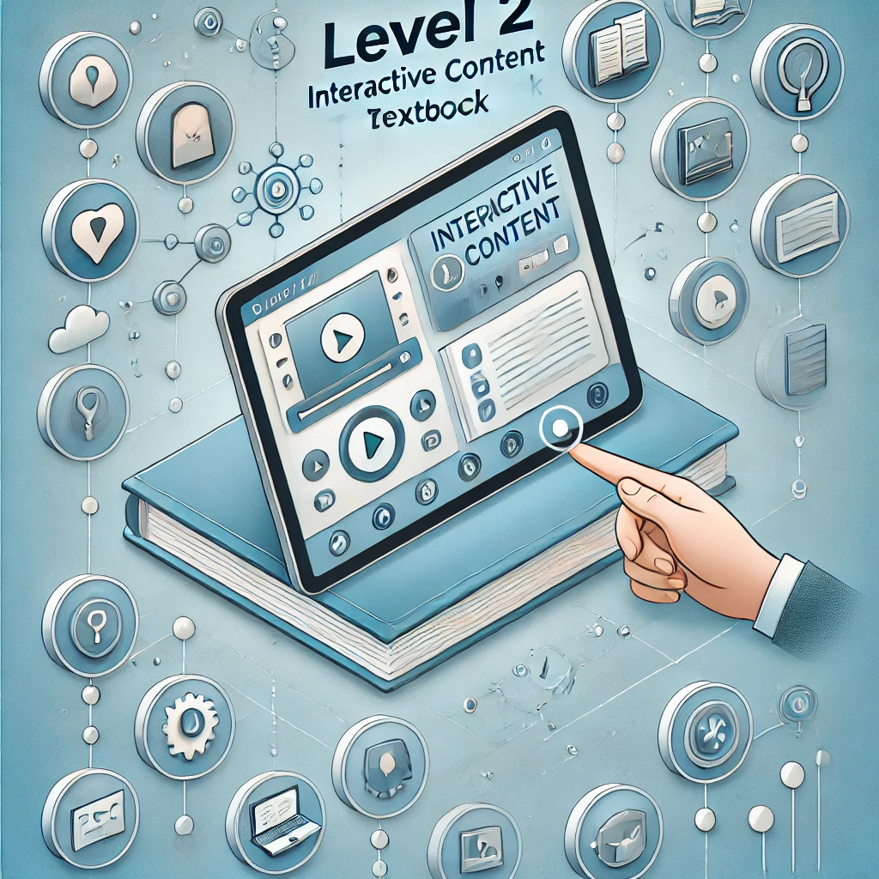
Level 2 – Interactive content
Online interactive
Links
Interactive charts
Simulations (MicroSims)
Animations
Level 2.9 took a lot of work before generative AI
No personalization

Slide 5
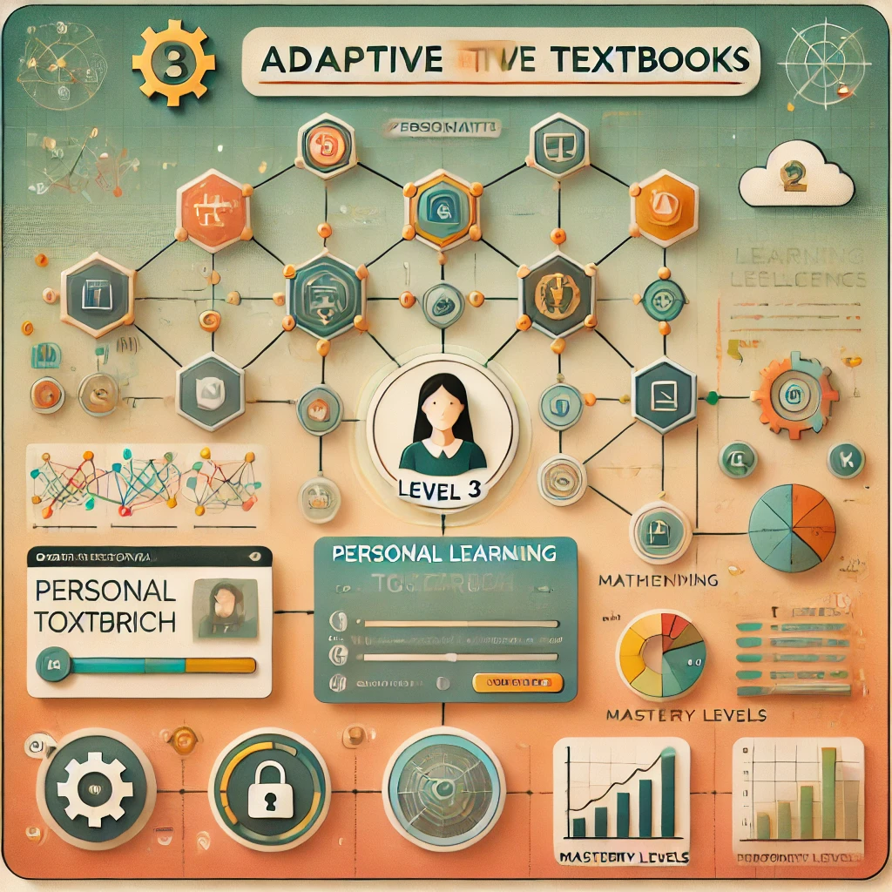
Level 3: Personalized Adaptive Textbooks
Personal Learning Paths: Customized content sequences based on prerequisite knowledge.
Concept Dependency Graphs: Visual maps showing how concepts connect.
Personal Learning Graphs: Tracking individual mastery of concepts.
Simple Algorithms for Recommendations: Content adapts based on quiz results or user input.
Privacy Considerations: Begins to collect personal data, emphasizing data protection.

Slide 6
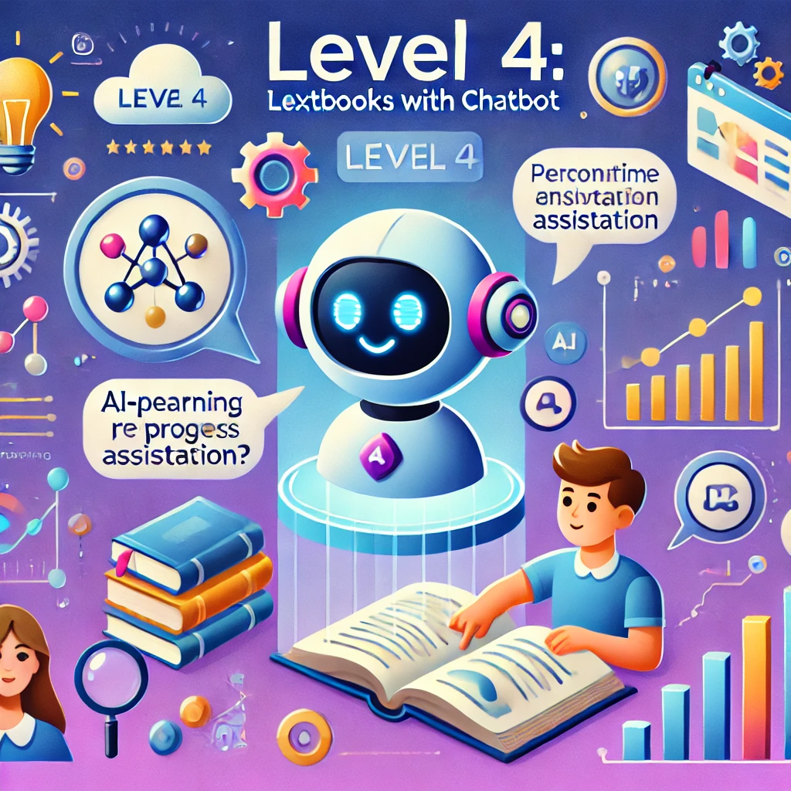
Level 4 – Chatbot
Sophisticated content generation
Personalized content
Conversational textbook

Slide 7
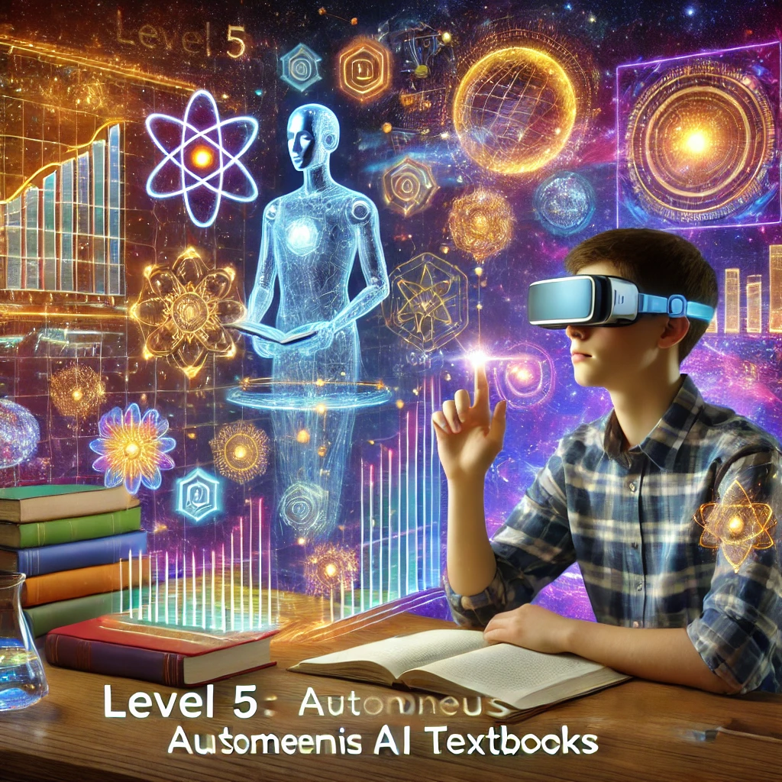
Level 5
“The Primer” as in Neal Stephenson’s book
Fully personalized
Generates complex simulations and immersive VR

Slide 8
References
https://chatgpt.com/share/67512e85-4a6c-8001-966a-4b83832d39c3

